Slide 1
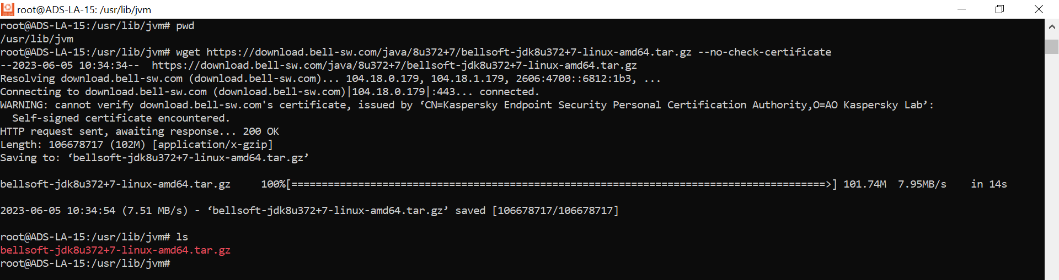
Installation and configuration of Nexus in Talend TAC
*Installation of java on the server
cd /usr/lib
mkdir jvm
cd /usr/lib/jvm

Slide 2
*Extract the tar.gz file
tar -xvzf openjdk-11.0.2_linux-x64_bin.tar.gz
*Set up the java path
cd /etc/profile.d
vi jdk.sh
*Save the file
Esc
:wq

Slide 3
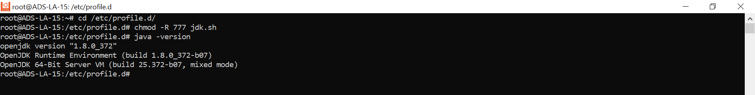
*Reboot the system
* Check the java version
java –version

Slide 4
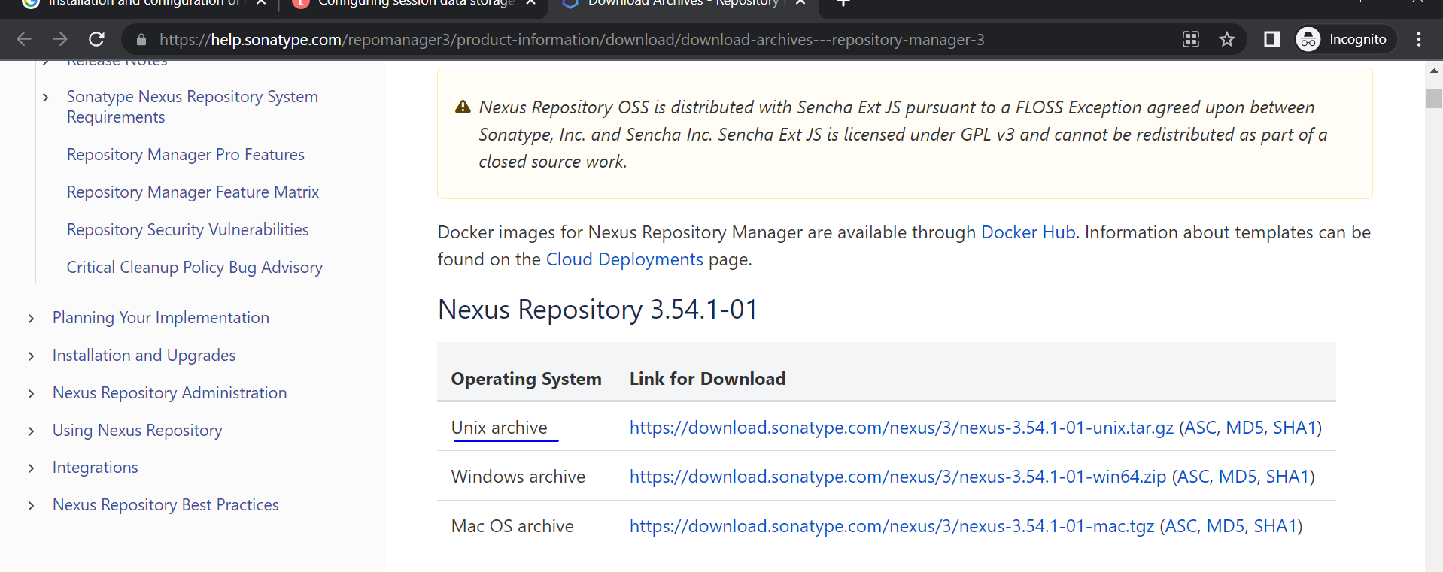
Step1:- Download the Nexus from the link get the latest version
https://help.sonatype.com/repomanager3/product-information/download/download-archives---repository-manager-3

Slide 5
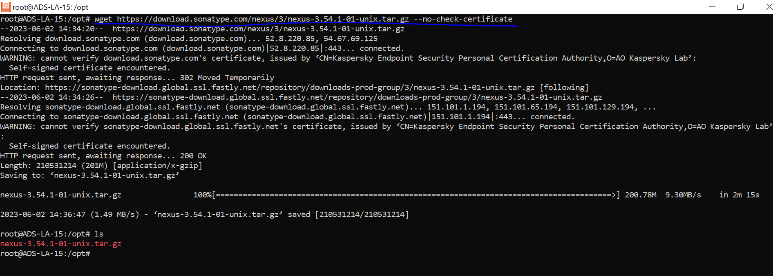
Step 2:- copy the link Address and paste it on linux server
cd /opt
wget https://download.sonatype.com/nexus/3/nexus-3.54.1-01-unix.tar.gz --no-check-certificate

Slide 6
Step 3:- Extract the Nexus file
tar -xvzf nexus-3.54.1-01-unix.tar.gz
*Check the files

Slide 7
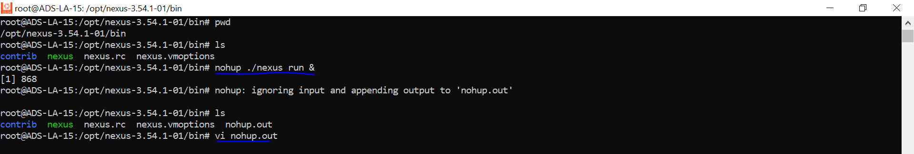
Step 4:- Start the Nexus
cd /opt/nexus-3.54.1-01/bin
*Run this command
nohup ./nexus run &

Slide 8
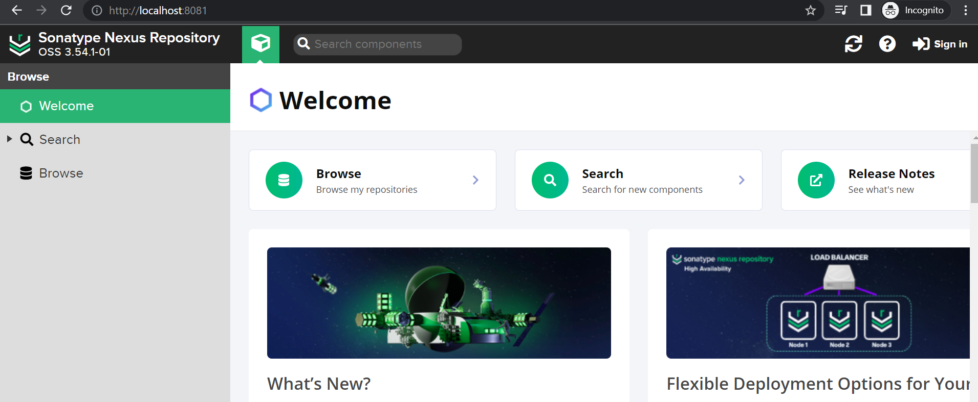
Step 5:- Check the nexus running on server
http://localhost:8081

Slide 9
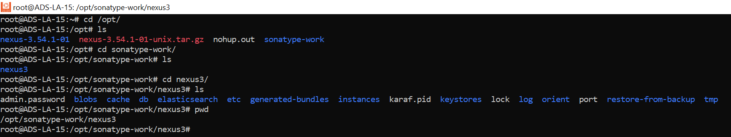
Step:- 6 sign in to the Nexus
cd /opt/sonatype-work/nexus3
vi admin.password
User:- admin
Copy the password from admin.password file

Slide 10
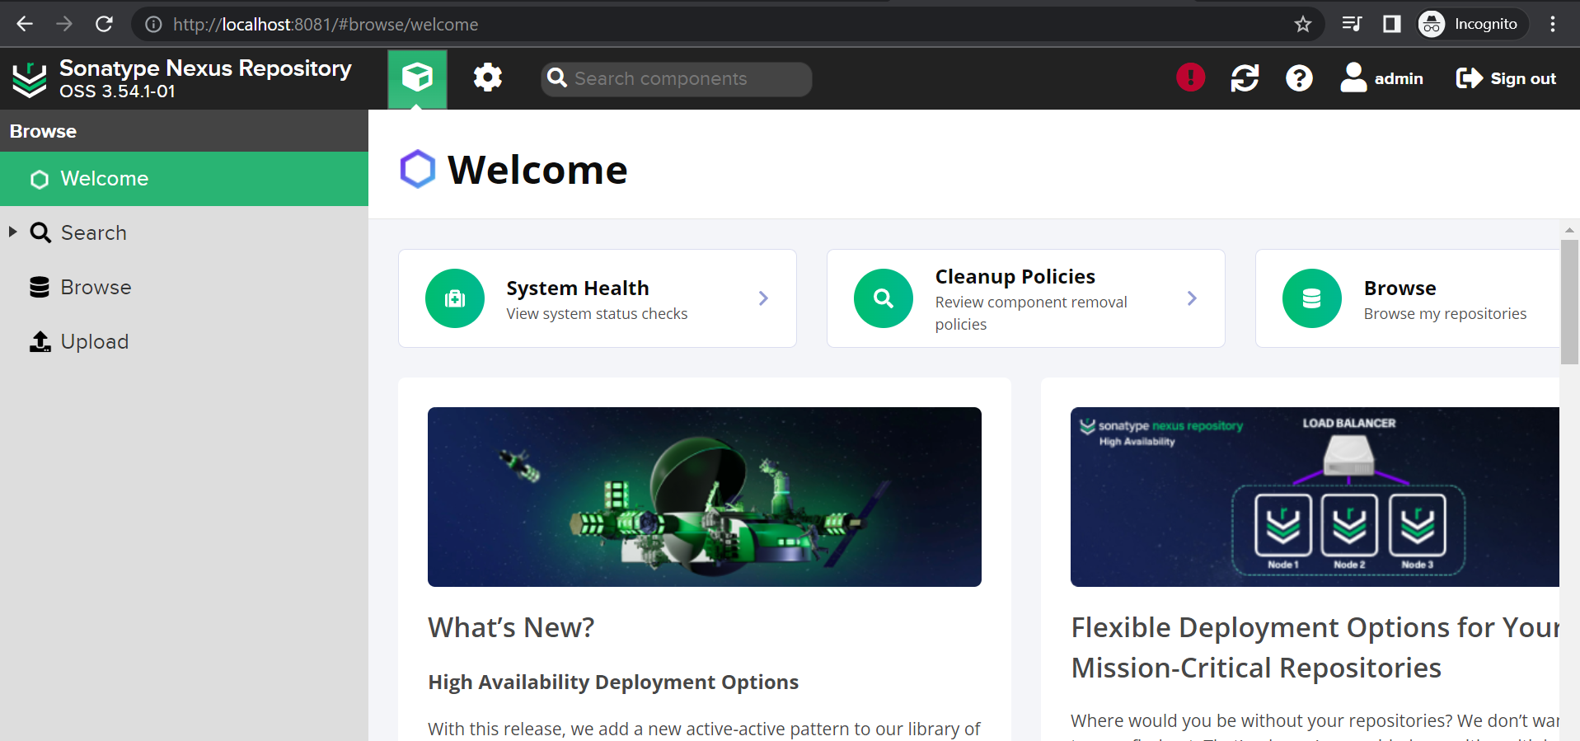
Step 7:- login to the nexus

Slide 11
Step 8:- Configuring the Nexus
Check the nexus should be up and running.
Go to the Sonatype Nexus Repository Manager interface.
Go to the Repositories tab to create the following repositories:
talend-updates
talend-custom-libs-snapshot
talend-custom-libs-release
a) Click Create repository.
Select maven2 (hosted) from the list.
Name your repository talend-updates.
Under the sub-section version policy, select Release.
Click Create repository to save your changes.
b) Create another maven2 (hosted) repository named talend-custom-libs-snapshot.
Under the sub-section version policy, select snapshot
Click Create repository to save your changes.
c) Create the last maven2 (hosted) repository and name it talend-custom-libs-release.
Under the sub-section version policy, select Release.
Click Create repository to save your changes.

Slide 12
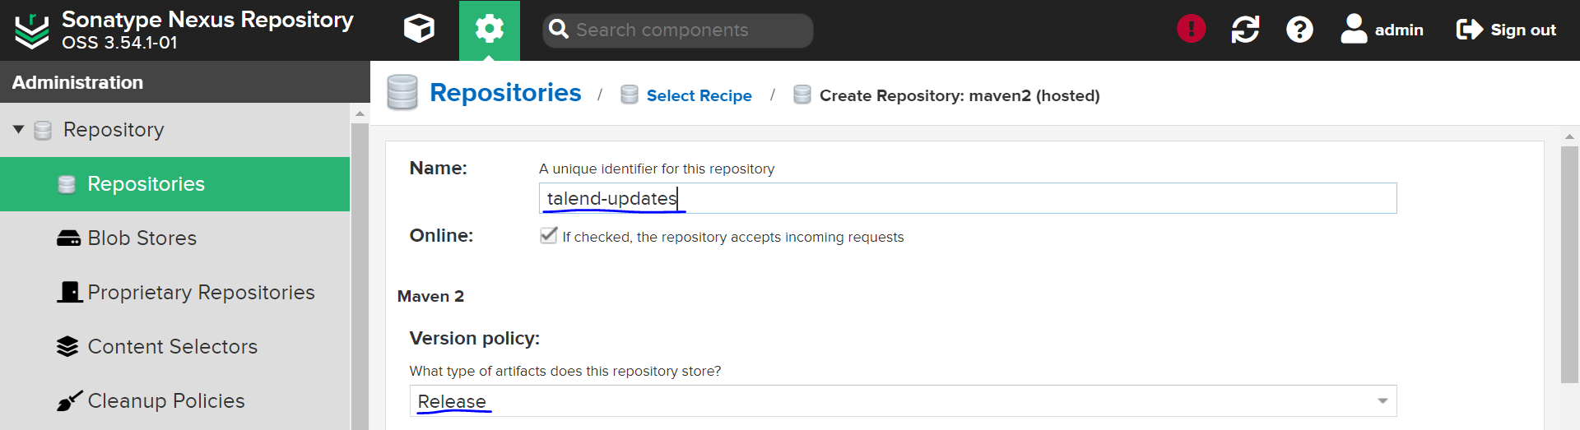
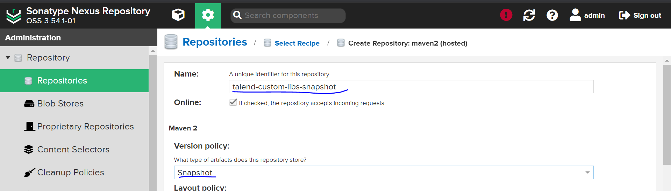

Slide 13

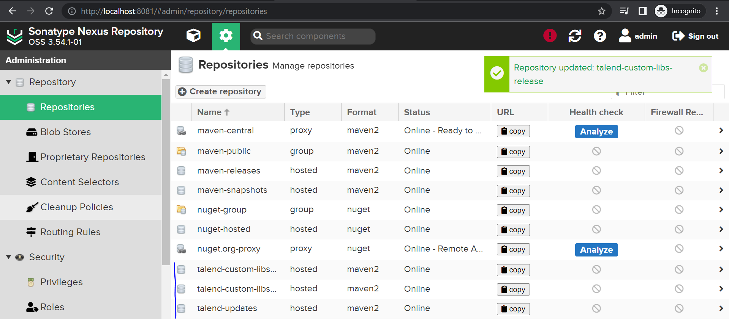

Slide 14
Go to the Roles tab, click Create role > Nexus role and create the following roles with the following privileges added to the Given list:
OPTION | DESCRIPTION
ROLE ID | PRIVILAGES
talend-updates-admin | nx-repository-view-maven2-talend-updates-add nx-repository-view-maven2-talend-updates-browse nx-repository-view-maven2-talend-updates-edit nx-repository-view-maven2-talend-updates-read nx-script-*-run
talend-updates-read-only | nx-repository-view-maven2-talend-updates-read nx-repository-view-maven2-talend-updates-browse nx-script-*-run
talend-custom-libs-admin | nx-repository-view-maven2-talend-custom-libs-release-add nx-repository-view-maven2-talend-custom-libs-release-browse nx-repository-view-maven2-talend-custom-libs-release-edit nx-repository-view-maven2-talend-custom-libs-release-read nx-repository-view-maven2-talend-custom-libs-snapshot-add nx-repository-view-maven2-talend-custom-libs-snapshot- browse nx-repository-view-maven2-talend-custom-libs-snapshot-edit nx-repository-view-maven2-talend-custom-libs-snapshot-read nx-script-*-run

Slide 15
talend-custom-libs-snapshot-read-only | nx-repository-view-maven2-talend-custom-libs-snapshot-browse nx-repository-view-maven2-talend-custom-libs-snapshot-read nx-script-*-run
talend-custom-libs-release-read-only | nx-repository-view-maven2-talend-custom-libs-release-browse nx-repository-view-maven2-talend-custom-libs-release-read nx-script-*-run
Add the roles in the roles and privileges in the roles subsection.

Slide 16
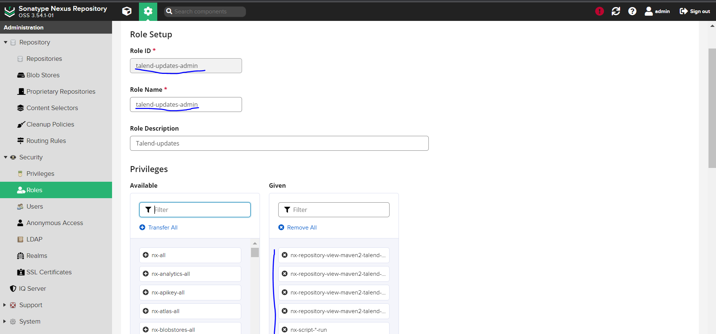

Slide 17
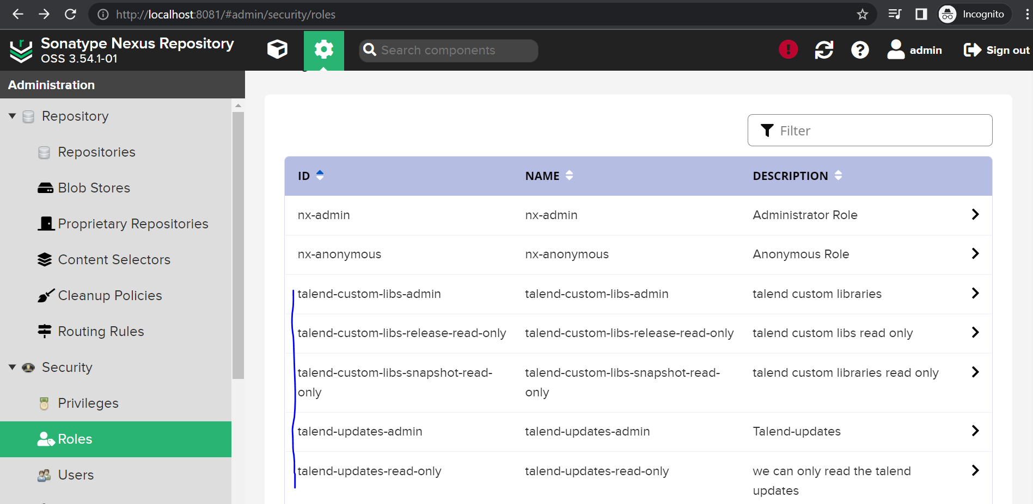

Slide 18
Step 9:- Under the Users tab, create the following users:
a) talend-updates-admin:
This user is used in Talend Administration Center Configuration > Software Update group. Talend Administration Center downloads the patch from Talend Update Server and uses this account to upload the patch to Nexus. Talend Studio can download the patch from Nexus without credentials.
b) talend-custom-libs-admin:
This user is used in Talend Administration Center Configuration > User Libraries group. Talend Studio gets the configuration information from Talend Administration Center to upload and download third-party libraries.
Click Create local user.
Write talend-updates-admin as the ID and fill the other required fields.
Go to the Roles sub-section and add talend-updates-admin to the Granted list.
Click Create local user.
Create the user with the talend-custom-libs-admin ID.
Go to the Roles sub-section and add talend-custom-libs-admin to the Granted list.
Open the admin user.
Add the nx-admin role to the Granted list.
Open the anonymous user.
Add the nx-anonymous, talend-custom-libs-release-read-only, talend-custom-libs-snapshot-read-only and talend-updates-read-only roles to the Granted list.

Slide 19
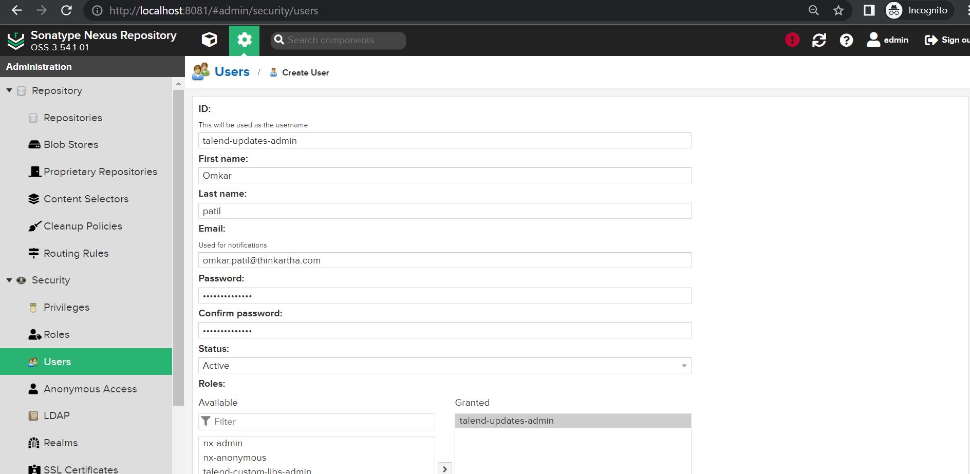

Slide 20
